Slide 1
Welcome
Emeritus Trustee Group Lunch May 13, 2022

Slide 2
Business Finance Program
The loan program was established to support business start-ups and expansions by increasing access to financing in our rural region.
Established in 1988
520 loans to date
$61 million in investments
$400 million leveraged

Slide 3
Grant Program
The loan program was established in 1988. We offer multiple lending tools to support start-ups and expansions.
Business Loans
Quick Turn Loans
Emerging Entrepreneur Loans

Slide 4
Business Finance Program
Among our financing vehicles:
Business Loans
Quick Turn Loans
Emerging Entrepreneur Loans

Slide 5
Program Fast Facts
Established in 1988
520 loans closed to date
$61 million invested in regional economy
$400 million leveraged from other sources
Often partner with other lenders

Slide 6
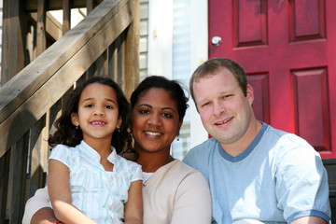
Program Fast Facts
45 communities served
520 loans to date
$400 million leveraged
Partnered with 20+ lenders

Slide 7
Current Statistics
Total Loaned since 1988 $58.5 million
Jobs Created/Retained 7,100
Leveraging Other Investments $310 million
Current Active Loans in Portfolio 119
Current Active Loan Amount $12.1 million
Current Capitalization $18.7 million

Slide 8
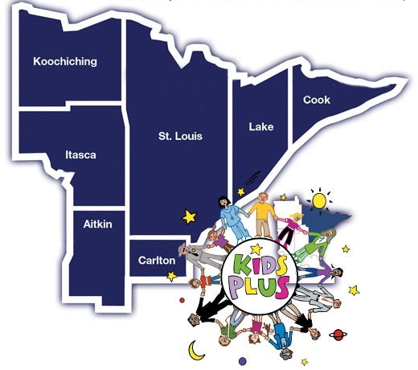
KIDS PLUS Program Initiatives

Slide 9
Thank You
Questions? Please contact us: 218.723.4040 • www.northlandfdn.org

