Slide 1



Boozhoo
(Hello/Welcome)
Maada’ookiing Indigenous-led Philanthropy
January 1, 2025

Slide 2

Land Acknowledgement
Insert a Land Acknowledgement statement here…

Slide 3
Slide Title Here
The program was established to support community work being done by Indigenous individuals and small, informal groups.
Established in May 2021
Indigenous-designed and led
Serving all or parts of 5 Tribal nations & 7 counties

Slide 4
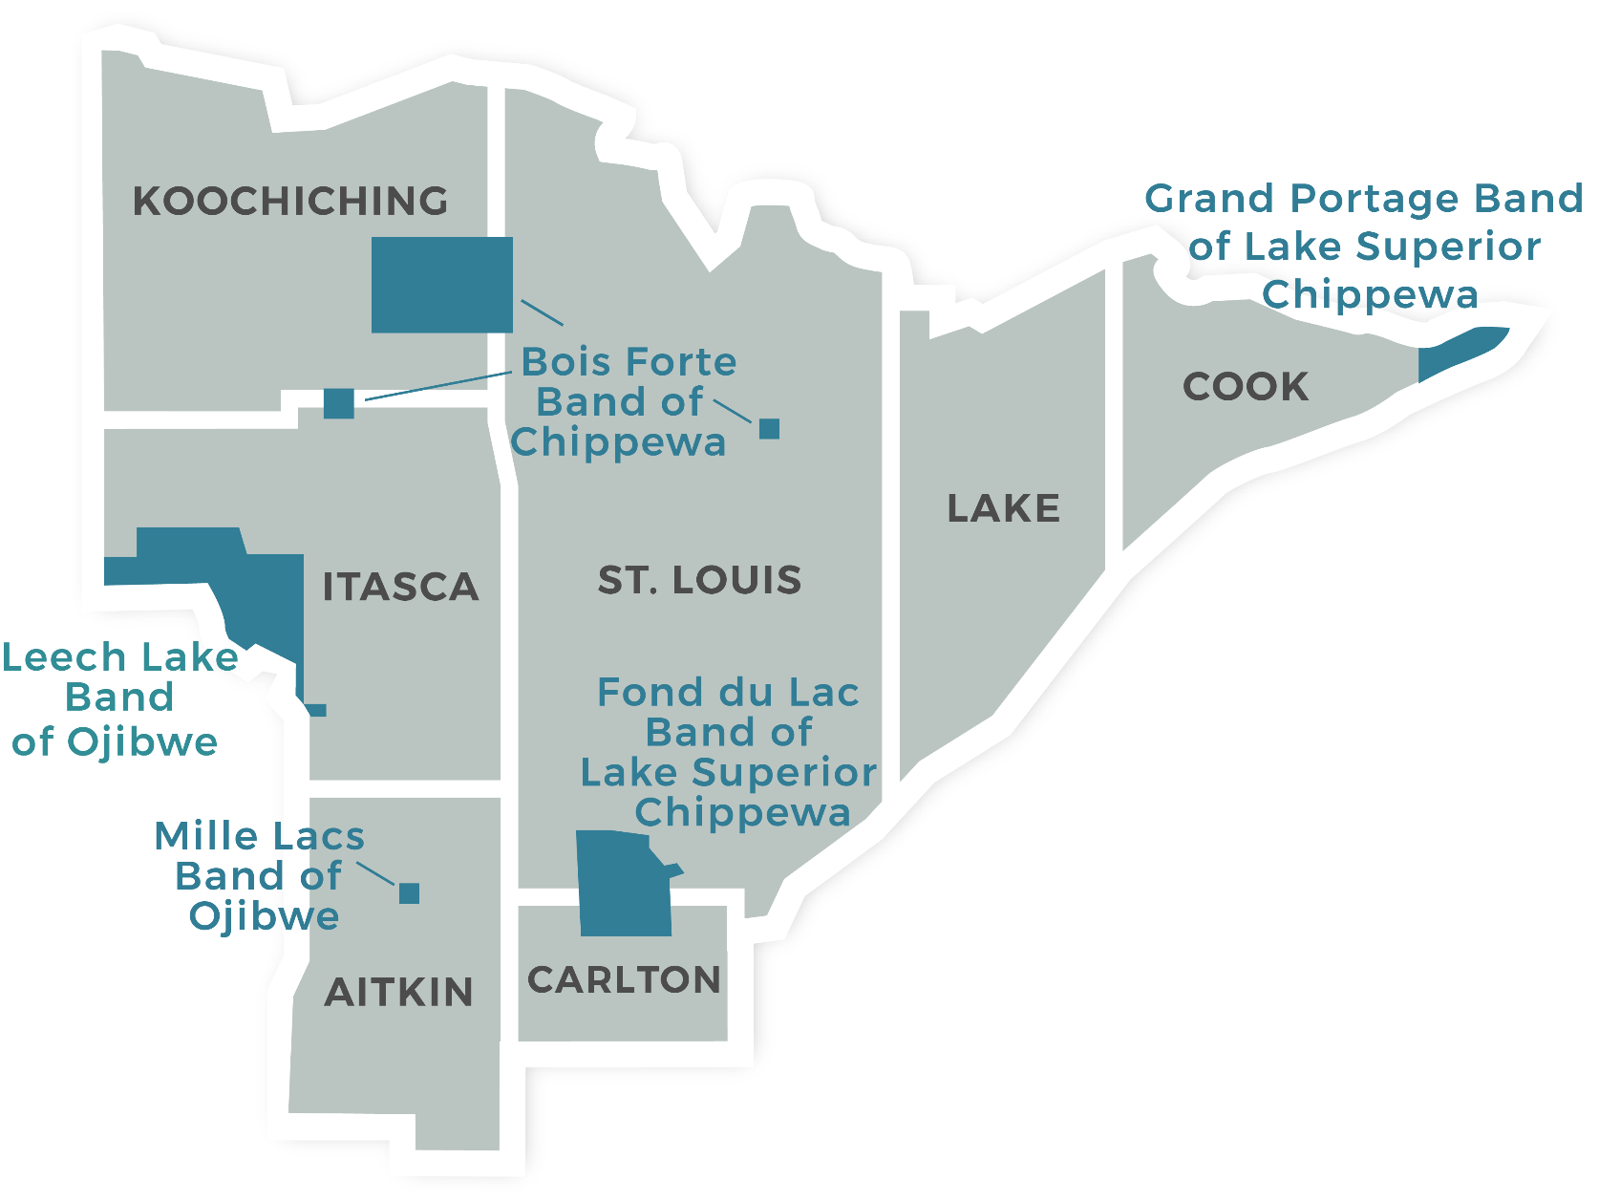
Slide Title Here

Slide 5
Slide Title Here

Slide 6
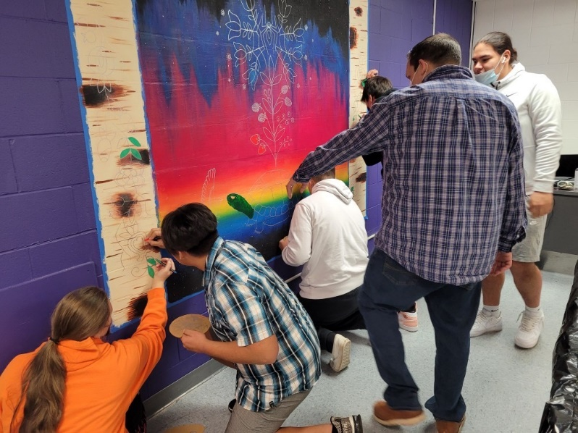
Slide Title Here
Body copy here.
Bullet
Bullet
Bullet

Slide 7
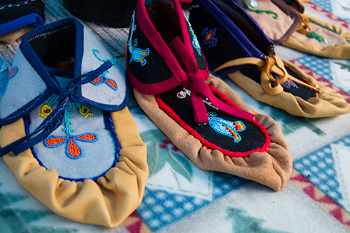
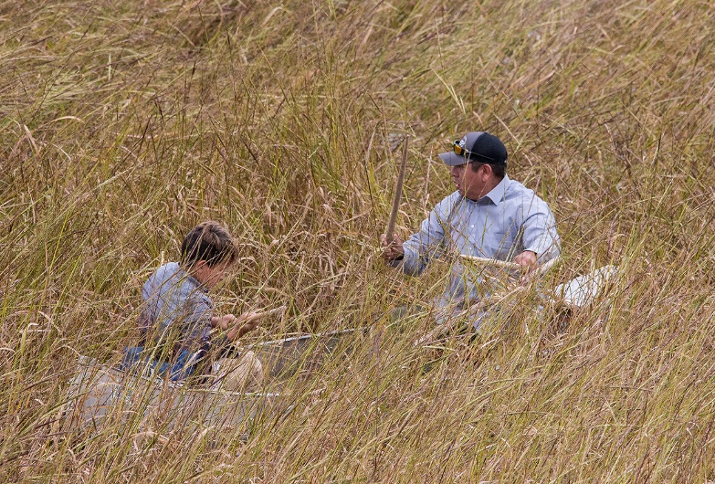
Slide Title Here
Centered or left justified body copy here:
Bullet
Bullet
Bullet
Photo by Ivy Vainio
Photo by Ivy Vainio

Slide 8
Slide Title Here
$58.5 million
7,100
$310 million
119
$12.1 million
$18.7 million
Total Loaned since 1988
Jobs Created/Retained
Leveraging Other Investments
Current Active Loans in Portfolio
Current Active Loan Amount
Current Capitalization

Slide 9
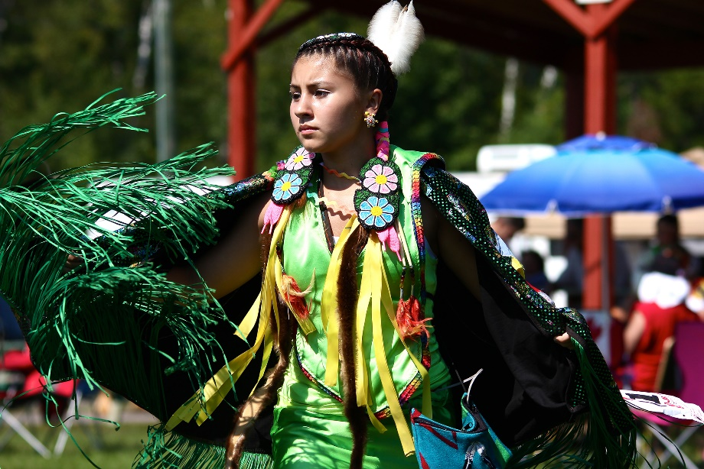
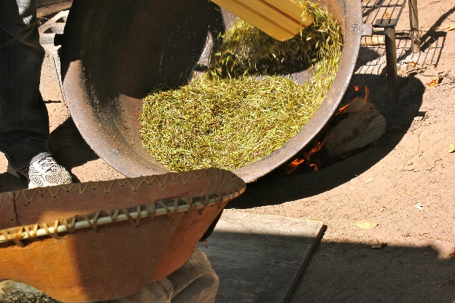
Slide Title Here
Lines of body copy to come here … Lines of body copy to come here … Lines of body copy to come here …
Photo by Ivy Vainio
Photo by Ivy Vainio

Slide 10

Slide Title Here
Could also use the central flower as a bullet point to make a slide more visually interesting
Could also use the central flower as a bullet point to
Could also use the central flower as a bullet point to

Slide 11
Miigwech
(Thank You)
Contact Us:
218.723.4040 • grants@northlandfdn.org

